Slide 1
TechReady Innovation Analysis as an Engagement Officer: Supporting Block holder Growth who have columns behind or ahead
Presented By
BIBEK LAMSAL

Slide 2
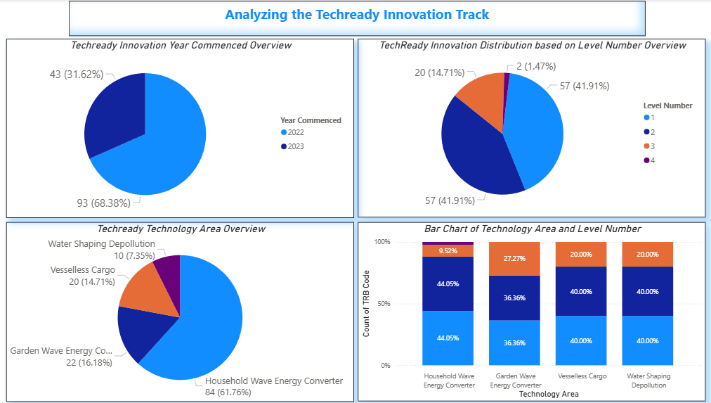
Visualization using dashboard

Slide 3
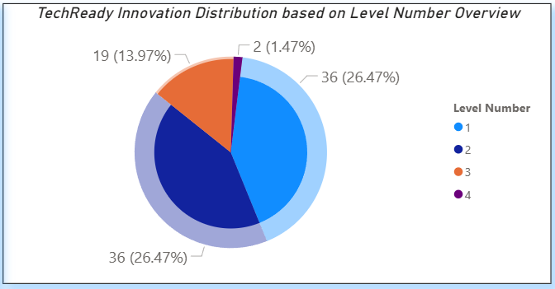
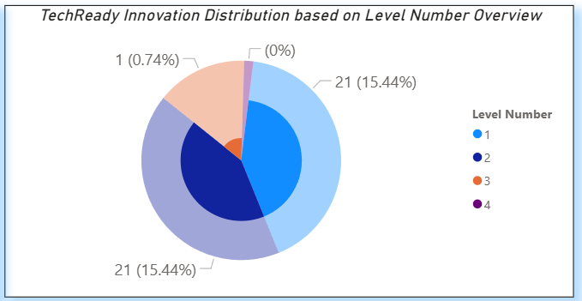
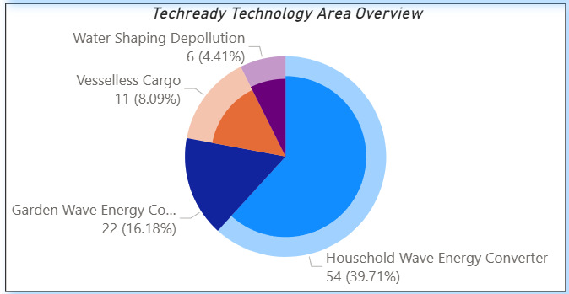
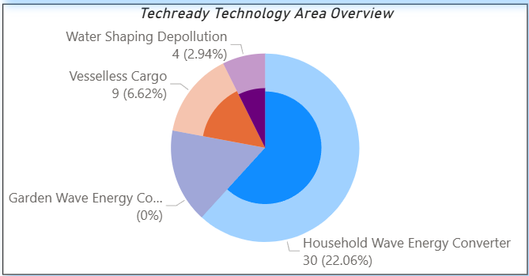
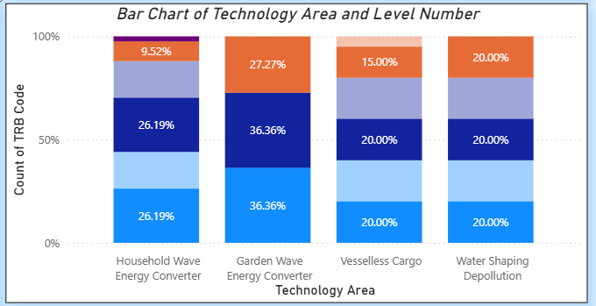
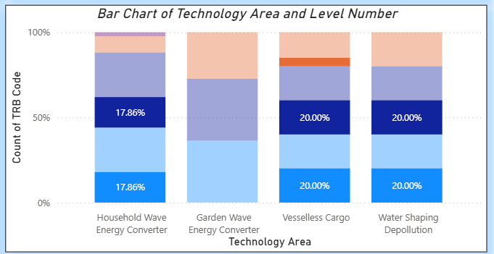
2022
2023

Slide 4
Innovation Dashboard Insights Report
1. Innovation Commencement Year Overview:
Year | Count | % of Total
2022 | 93 | 68.38%
2023 | 43 | 31.62%
Most innovations (68.38%) were initiated in 2022, with a noticeable drop in 2023 (31.62%), indicating a slowdown in new project commencements.
2. 2022 vs 2023 Level-wise Distribution:
Year | Level 1 | Level 2 | Level 3 | Level 4
2022 | 36 (26.47%) | 36 (26.47%) | 19 (13.97%) | 2 (1.47%)
2023 | 21 (15.44%) | 21 (15.44%) | 1 (0.74%) | 0 (0%)
Total % | 57 (41.91%) | 57 (41.91%) | 20 (14.71%) | 2 (1.47%)
Most innovations remained concentrated at Level 1 and Level 2 across both years (79.41%), while higher maturity levels (Level 3 and 4) were limited, reflecting early-stage project focus.
3. Technology Area Distribution by Year (2022 & 2023):
Technology Area | 2022 (%) | 2023 (%) | Total Projects (%)
Household Wave Energy Conv. | 54 (39.71%) | 30 (22.06%) | 84 (61.76%)
Garden Wave Energy Conv. | 22 (16.18%) | 0 (0%) | 22 (16.18%)
Vesselless Cargo | 11 (8.09%) | 9 (6.62%) | 20 (14.71%)
Water Shaping Depollution | 6 (4.41%) | 4 (2.94%) | 10 (7.35%)
Total Projects | 93 (68.38%) | 43 (31.62%) | 136 (100%)
"Household Wave Energy Converter" dominated in both years with 61.76% of total projects, while "Garden Wave Energy Conversion" disappeared in 2023, suggesting changing strategic priorities.
4.Technology Area vs Level Distribution:
Technology Area | Level 1 (%) | Level 2 (%) | Level 3 (%) | Level 4 (%)
Household Wave Energy Conv. | 37 (44.05%) | 37 (44.05%) | 8 (9.52%) | 2 (2.38%)
Garden Wave Energy Conv. | 8 (36.36%) | 8 (36.36%) | 6 (27.27%) | 0
Vesselless Cargo | 8 (40.00%) | 8 (40.00%) | 4 (20.00%) | 0
Water Shaping Depollution | 4 (40.00%) | 4 (40.00%) | 2 (20.00%) | 0
Across all technology areas, most projects are clustered at Level 1 and Level 2, with very few reaching Level 3 or 4, indicating a need to push more projects toward advanced development stages.
5. Year-wise Technology Area Trends:
Technology Area | 2022 (%) | 2023 (%) | Change (pp) | Trend
Household Wave Energy Conv. | 39.71% | 22.06% | ↓ 17.65 | Decreasing
Garden Wave Energy Conv. | 16.18% | 0.00% | ↓ 16.18 | Discontinued
Vesselless Cargo | 8.09% | 6.62% | ↓ 1.47 | Slight Decline
Water Shaping Depollution | 4.41% | 2.94% | ↓ 1.47 | Slight Decline
A clear downward trend is observed in innovation across all technology areas from 2022 to 2023, especially in "Household" and "Garden Wave Energy", pointing to reduced diversification and momentum.

Slide 5
RecommEndation
1. Accelerate Progress Beyond Early Stages (85% in Level 1, 2): Most innovations remain in early development phases, indicating limited progression. Encourage advancement to Level 3 by leveraging successful third-level projects as benchmarks to guide and accelerate similar initiatives.
2. Strengthen Advancement at the Production Stage (Level 3): With only 1.47% of projects reaching Level 4 (Initial Testing), it is essential to prioritize transitioning Level 3 (Early Prototype – 14.71%) innovations forward. Use current Level 4 examples to model success and streamline the path to testing and implementation.
3. Utilize High-Performing Areas as Peer Catalysts: "Household Wave Energy Conversion" stands out in both volume and maturity. Empower blocks in Level 3 or 4 to mentor or collaborate with earlier-stage teams, promoting peer-driven development and balanced growth across all innovation domains.

Slide 6
Call To Action
Let’s set a meeting with the TechReady Innovation Support team to brainstorm and identify successful practices from Level 3 and 4 initiatives that can serve as effective models to guide and accelerate early-stage innovation (Level 1 and 2).

